Slide 1
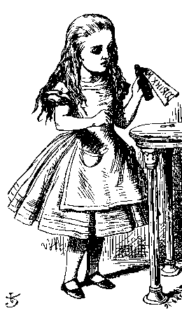
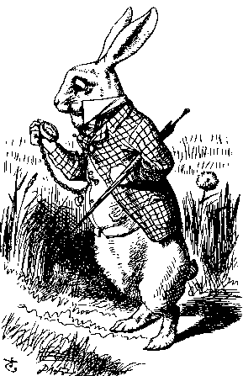
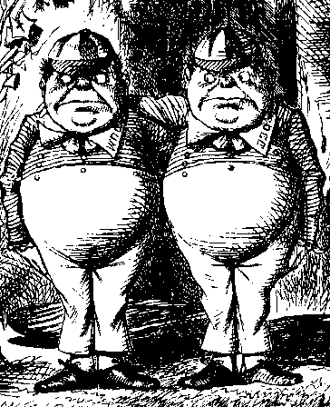





1. Encrypt DH exchange with symmetric key
$$Public=g,p$$
$$K = g^{ab} mod p$$
Symmetric Key SK
Alice
Bob
$$E(g^{a} mod p,SK)$$
$$D(E\left(g^{a} mod p,SK\right),SK)$$
$$D(E\left(g^{b} mod p,SK\right),SK)$$
$$E(g^{b} mod p,SK)$$
??
Trudy

Slide 2





2. Encrypt DH exchange with public key
$$Public=g,p$$
$$K = g^{ab} mod p$$
Encrypt M with Trudy’s private key: $C={\{M\}}_{Trudy}$
Decrypt C with Trudy’s public key: ${M=[C]}_{Trudy}$
Alice
Bob
$${\{g^{a} mod p\}}_{Bob}$$
$${[{\{g^{a} mod p\}}_{Bob}]}_{Bob}$$
$${[{\{g^{b} mod p\}}_{Alice}]}_{Alice}$$
$${\{g^{b} mod p\}}_{Alice}$$
??
Trudy

Slide 3





3. Sign DH exchange with private key
$$Public=g,p$$
$$K = g^{ab} mod p$$
Sign M with Trudy’s private key: $S={[M]}_{Trudy}$
Decrypt S with Trudy’s public key: ${M=\{S\}}_{Trudy}$
Alice
Bob
$${[g^{a} mod p]}_{Alice},g^{a} mod p$$
$${\{{\left[g^{a} mod p\right]}_{Alice}\}}_{Alice},g^{a} mod p$$
$${\{{\left[g^{b} mod p\right]}_{Bob}\}}_{Bob},g^{b} mod p$$
$${[g^{b} mod p]}_{Bob},g^{b} mod p$$
??
Trudy

